Slide 1
Data Inc. - Who should we hire? By: Zach D’Urso

Slide 2
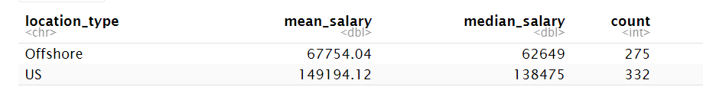
Offshore versus US
Offshore average annual salary is significantly lower than US
On average there is roughly an $81,000 difference in hiring a candidate based on their location
When considering hiring data related talent, it makes sense to look for offshore candidates instead of US
It makes sense to offer offshore candidates an annual salary within the $60,000-$70,000 range, offering a salary on the higher end for more experienced candidates
An appropriate range for our candidate after considering remote work and experience level is more likely to be $67,000-$82,000

Slide 3
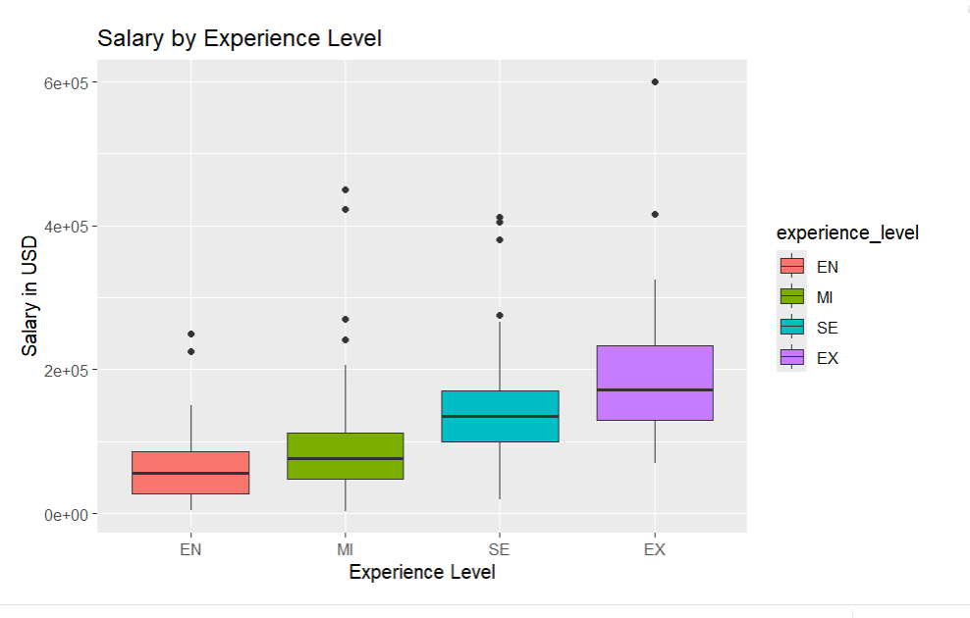
How does Experience level impact salary?
Hiring expert level candidates is too expensive and an entry level candidate would not have as many skills and as much experience as a mid-level or senior candidate
It makes most sense to hire either a mid or senior-level candidate because the average salary is much lower than expert-level candidates and those levels have greater experience than entry-level
Mid and senior-level candidates are worth the salary investment due to their experience levels, especially because we will outsource from offshore locations
If we want our company to grow, this makes the most sense experience-wise

Slide 4
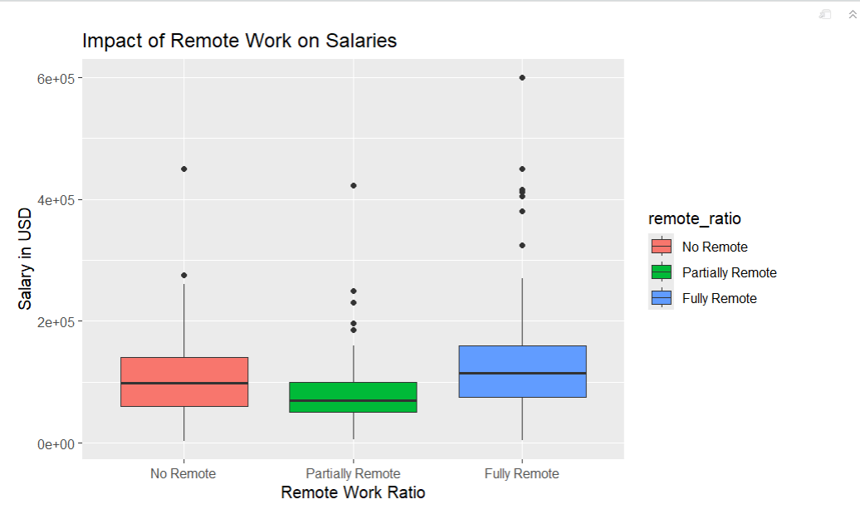
How expensive is Remote work?
On average, fully remote jobs entail a higher salary
Partially remote positions are the cheapest, but offshore candidates would need to relocate, and it could be difficult to find candidates willing to relocate
Hiring offshore candidates and allowing them to live in their country and work full-time in a fully remote capacity would make sense if candidates aren’t willing to relocate and work partially remote
This is a cost worth enduring as hiring offshore talent is significantly cheaper no matter which remote capacity

